Slide 1
Evil & God
Unlocking Your Faith
Habakkuk 1:3-4
Psalm 11

Slide 2
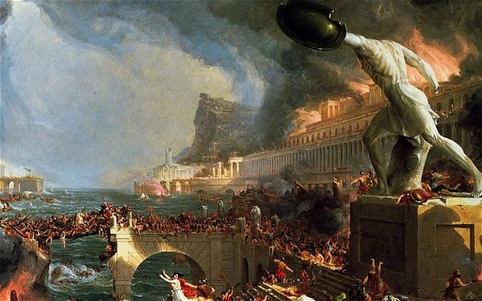
The Sacking of Rome 410

Slide 3
Augustine’s City of God
Written between 413-423
Written in Latin
Augustine’s most comprehensive work
Contains almost 1,000 pages

Slide 4
Habakkuk 1:2
² How long, LORD, must I call for help, but you do not listen?
Or cry out to you, “Violence!” but you do not save?

Slide 5
Possible Reasons for Unanswered Prayer
Wrong motives – James 4:3
Unconfessed sin – Isaiah 59:1-2
Idols of the heart – Ezekiel 14:3
Lack of care – Proverbs 21:3
Doubt – James 4:6-7
Not God’s will – 1 John 5:14

Slide 6
Habakkuk 1:3-4
3 Why do you make me look at injustice? Why do you tolerate wrongdoing? Destruction and violence are before me; there is strife, and conflict abounds.

Slide 7
Habakkuk 1:3-4
4 Therefore the law is paralyzed, and justice never prevails. The wicked hem in the righteous, so that justice is perverted.

Slide 9
Psalm 11:2-3
2 For look, the wicked bend their bows; they set their arrows against the strings to shoot from the shadows at the upright in heart.
3 When the foundations are being destroyed, what can the righteous do?

Slide 10
Habakkuk 1:4
4 Therefore the law is paralyzed, and justice never prevails. The wicked hem in the righteous, so that justice is perverted.

Slide 12
Observation 1
Just because we can’t see God’s hand, doesn’t mean He isn’t working

Slide 13
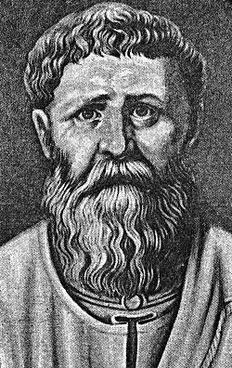
“Faith is believing what we do not see, and the reward of this faith is to see what we believe.”
Augustine (354-430)

Slide 14
2 Chronicles 33:13
And when he prayed to him, the Lord was moved by his entreaty and listened to his plea; so He brought him back to Jerusalem and to his kingdom. Then Manasseh knew that the Lord is God.

Slide 15
Observation 2
We can be thankful that God does not judge all evil right now

Slide 16
2 Peter 3:9
The Lord is not slow in keeping His promise, as some understand slowness. Instead He is patient with you, not wanting anyone to perish, but everyone to come to repentance.

Slide 17
Observation 3
Sometimes God allows the evil to continue because He is waiting for their sin to reach its “full measure”

Slide 18
Genesis 15:13-16
“In the fourth generation your descendants will come back here, for the sin of the Amorites has not yet reached its full measure.”

Slide 19
Romans 1:18
The wrath of God is being revealed from heaven against all the godlessness and wickedness of people, who suppress the truth by their wickedness,

Slide 20
Observation 4
Evil is not unique to
any one city or people

Slide 21
Judges 4:1-2
Again the Israelites did evil in the eyes of the Lord, now that Ehud was dead. ² So the Lord sold them into the hands of Jabin king of Canaan, who reigned in Hazor.

Slide 22
Observation 5
God is in the midst of the evil

Slide 23
Psalm 11:4-7
The Lord is in His holy temple; the Lord is on His heavenly throne.
He observes everyone on earth; His eyes examine them.

Slide 24
Psalm 11:4-7
The LORD examines the righteous, but the wicked, those who love violence, He hates with a passion.
On the wicked He will rain fiery coals and burning sulfur; a scorching wind will be their lot.

Slide 25
Psalm 11:4-7
For the LORD is righteous, He loves justice; the upright will see His face.

Slide 26
Faith Key #3
Trust
Cling to God

Slide 27
Confidence in the sovereignty of God is crucial to our trusting Him. If there is a single event in all of the universe that can occur outside of God’s sovereign control then we cannot trust Him.
~ Jerry Bridges

Slide 28
Of what do you need to let go?

Slide 30
Psalm 11:1
In the Lord I put my trust; How can you say to my soul, “Flee as a bird to your mountain”?

Slide 31
Faith
Trusting God

